Slide 1
Draft Electric Vehicle (EV) Infrastructure Planning Process and Timeline
*This downloadable PowerPoint document can be modified and placed in your organization’s branded template

Slide 2
How To Use This Slide Deck
Use this slide deck to outline the steps, activities, and deadlines associated with your EV infrastructure planning process. Detailing this process can help you and your project team better envision the pathway to meet your ultimate goals and the staffing and resources you’ll need to get there.
Detail your planning timeline, which should include any milestones, deadlines, activities, and parallel or complementary planning or engagement efforts that might dovetail with this effort.
Review these template slides, examples, and included resources. Read the comments that describe how to use or edit each slide.
Make the changes you want to incorporate and convert the elements of your planning timeline into this deck.
Use the deck to communicate your planning process to internal and external partners.

Slide 3
Local governments can support EV infrastructure deployment in a variety of ways.
[local government name] may want to include some or all of these elements in a plan.
Create community EV charging plans
Track and communicate progress
Develop policies and streamline permitting and zoning
Local Governments
Develop compatible equity strategies
Provide publicly accessible chargers
Engage with utilities
Incentivize private deployment

Slide 4
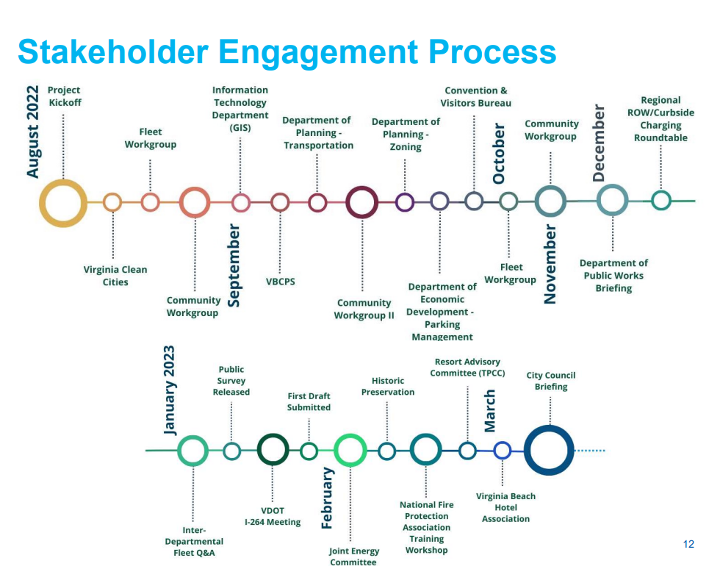
Who will we engage, when, and how?
Example stakeholder engagement process from Virginia Beach’s Electric Vehicle Community Charging Plan

Slide 5
Months 1-6
Review Local Policies
Review local zoning, permitting and inspection, and building codes and policies to identify barriers to EV infrastructure. Develop a list of recommended updates to include as steps in your plan.
Present project status with internal leadership at quarterly meeting
Host pop-up engagement at community fair
Complete Contextual Policy Scan
Document existing federal, state, and utility programs and incentives to understand opportunities.
Gather internal and stakeholder input on the proposed planning process
Establish Goals and Metrics
Develop goals, associated targets and metrics, and a plan for how you will track them.
Month Year
Month Year
Month Year
Month Year
Month Year
Month Year
Project Future EV Charging Infrastructure Needs
Use EVI-Pro Lite and industry standard projections or local EV adoption goals to understand your charging needs over the next 20 years.
Engage with residents of select neighborhoods
Learn about their priorities and build trust.
Draft Procurement Process
Use data gathered from analysis and engagement to draft goals, outcomes, activities, and indicators within an EV infrastructure plan.
Reengage with residents of select neighborhoods to share updates and gather additional insights
Complete First Draft of Plan
Brief Council and the Public
Offer a comment period and revise the plan based on input.

Slide 6
Months 7-12
Activity | To Begin: | Duration
Get approval from Council or other decision maker | January 2024 | 1-2 months
Engage with community organizations and residents in our jurisdiction to discuss how best to implement the plan together. | February 2024 | 3-4 months
Begin procurement process | June 2024 | 1-2 months
Implement plan in priority areas first – be transparent about how those are selected | August 2024 | 6-8 months
Implement plan; track and communicate progress with community and stakeholders | March 2025 | Ongoing

